Slide 1
MOF
ESTO
Outlook for U.S. Travel and Tourism
Dr. Suzanne D. Cook
Travel Industry Association

Slide 2
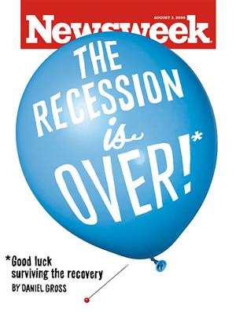
Conclusion 1

Slide 3
Economy Trends
Signs that economy has turned positive
Leading indicators turning up
Housing sector beginning to recover in sales and prices
Early positive signs in retail sector
No signs of inflation
But consumers remain in a funk
Declines in payrolls have slowed but unemployment approaching 10%; will continue to rise to over 10% by mid-2010
But improvement should not be confused with a return to normality

Slide 4
U.S. Economic Outlook
2009p 2010F
Unemployment Rate 9.3% 10.1%
CPI -0.4% +1.8%
Real Personal Disp Income +0.5% +1.0%
Real Consumer Spending -0.6% +1.9%
Real GDP -2.5% +2.5%
Total Profits -7.8% +9.5%
Source: Oxford Economics

Slide 5
Conclusion 2
A “New Normal” has taken hold….
Maybe
Or at least for the next few years

Slide 6
Consumer Confidence remains tepid
53.1
1985 = 100
Source: The Conference Board, September 29, 2009

Slide 7
Gallup Daily: behavioral measurement of consumer spending shows average daily spending plunged over the past year
Next, we’d like you to think about your spending yesterday, not counting the purchase of a home, motor vehicle, or your normal household bills. How much money did you spend or charge yesterday on all other types of purchases you may have made, such as at a store, restaurant, gas station, online, or elsewhere?
Average Daily Spending
Copyright © 2009 Gallup, Inc. All rights reserved.
Notes:
Right now, do you think that economic conditions in the country as a whole are getting better or getting worse?

Slide 8
Standardizing consumer confidence and spending clarifies that the two are NOT positively related (by monthly average since Jan 2008)
Consumer Confidence by Month
Spending by Month
Copyright © 2009 Gallup, Inc. All rights reserved.

Slide 9
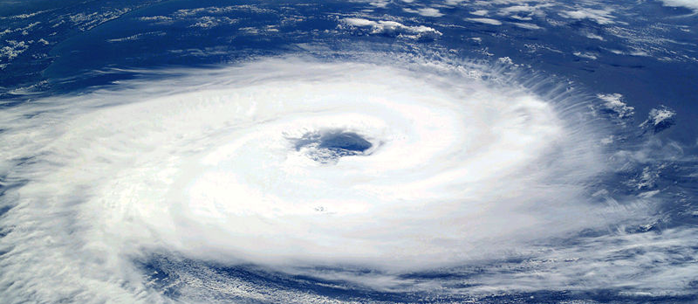
Are we in in a cycle???

Slide 10
Traveler Sentiment Index™(TSI) stabilizes
Source: U.S. Travel Association/YPartnership travelhorizons™

Slide 11
“Affordability of Travel” Index Still Strong
Source: U.S. Travel Association/YPartnership travelhorizons™

Slide 12
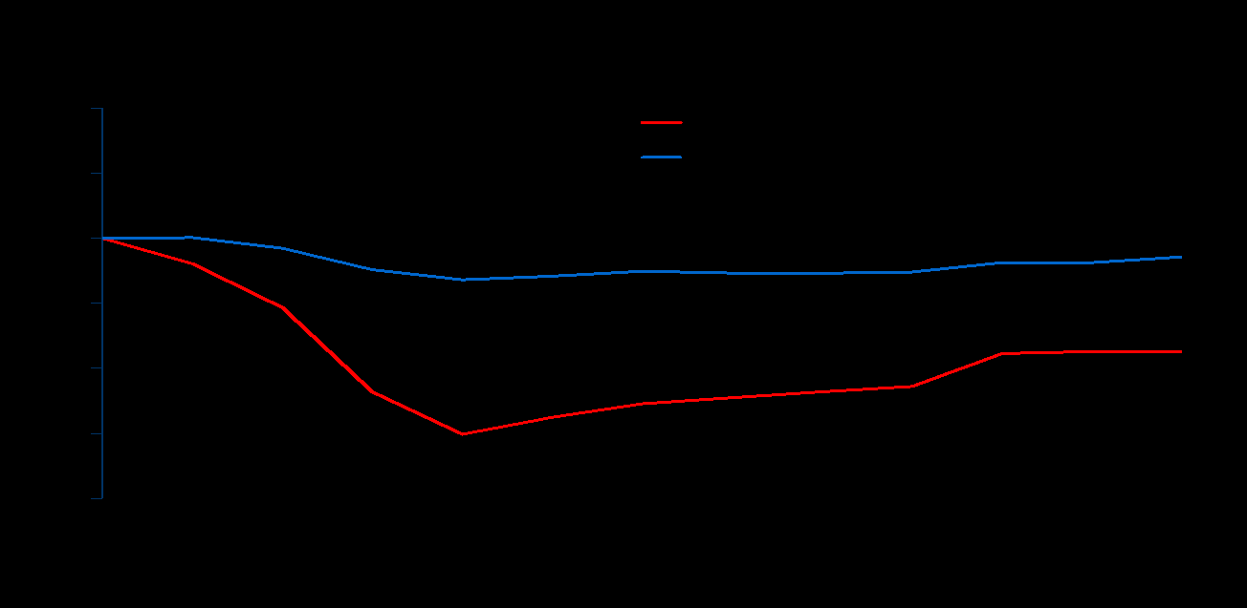
Travel prices lag inflation

Slide 13
Most travel prices in decline
Travel Price Index through August 2009
Source: U.S. Travel Association Travel Price Index – August 2009

Slide 14
“Money Available for Travel” Index stabilizing but remains weak
Source: U.S. Travel Association/YPartnership travelhorizons™

Slide 15
Conclusion 3
Declines in travel bottoming out

Slide 16
Visitor Volume Through First 9 Months of ‘09
Domestic Leisure | Domestic Business | International * | Total
- 2.7%
- 7.5%
- 4.1%
- 9.5%
*Through July
Sources: U.S. Travel Association; Oxford Economics/Tourism Economics; U.S. Department of Commerce-Office of Travel and Tourism Industries

Slide 17
Visitor Spending Through First 9 Months – The Larger Issue
Domestic Leisure | Domestic Business | International* | Total
- 10.3%
- 13.6%
- 12.0%
- 17.5%
*Through July
Sources: U.S. Travel Association; Oxford Economics/Tourism Economics; U.S. Department of Commerce-Office of Travel and Tourism Industries

Slide 18
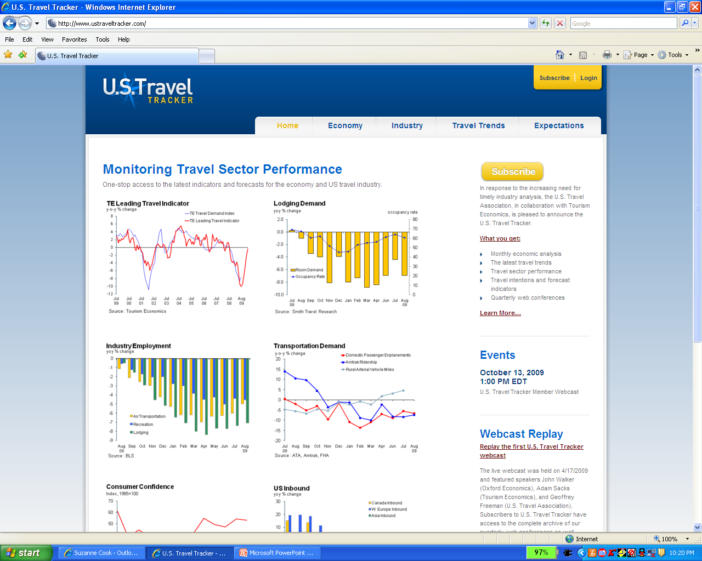
U.S. Travel Tracker

Slide 19
Transportation demand beginning to rise

Slide 20
Declines in U.S. airline traffic “less bad”

Slide 21
Hotel demand Improving...Slowly

Slide 22
% change in hotel demand through September 2009
-5% to -5.9%
-6% to -6.9%
7% to -7.9%
-8% to -8.9%
-9% or more
Source: Smith Travel Research

Slide 23
Hotel RevPar declines still dramatic

Slide 24
% change in hotel RevPAR through September 2009
-11% to -13.9%
-14% to -16.9%
17% to -19.9%
-20% or more
Source: Smith Travel Research

Slide 25
The Hotel Market Cycle We Are at the Bottom
Rapid Development
Equilibrium ADR
Development
Picks Up
Rapid Development
Lodging Decline, Leads Other Sectors
L.T. Average
U.S. is Here
Long Run
Occupancy
ADR and Margins Recover
Occupancy Declines, ADR Follows
Development Slows
Occupancy Recovers
Development at Minimum Levels
Lodging Recovers, Lags Other Sectors

Slide 26
Global tourism in decline
% change over prior year
Source: UN World Tourism Organization

Slide 27
International visitation to U.S. down even more

Slide 28
Top Origin Markets for International Travelers to the U.S.
Origin of Visitor 2008 08 / 07 09/08 Aug. YTD
(000s) (% change) (% change)
International Total * 58,015 4% -9%
1 Canada 18,910 7% -8%
2 Mexico 13,763 -4% -6%
Overseas ** 25,341 6% -9%
3 United Kingdom 4,565 1% -16%
4 Japan 3,250 -8% -16%
5 Germany 1,782 17% -6%
6 France 1,244 25% -3%
7 Italy 779 23% -7%
8 Brazil 769 20% 11%
9 South Korea 759 -6% -11%
10 Australia 690 3% -2%
* International travelers include all countries generating visitors to the U.S.
** Overseas includes all countries except Canada and Mexico.
Notes:
28
Here’s the performance by origin market for 2008 and for 2009 YTD. Total international and Mexico YTD reflects only the portion of Mexico captured by the I-94 program, which is all air travel and border traffic beyond the official 40km border zone. This portion is typically about a third of total Mexico annually.
2008 EOY Highlights:
* 17 of the top 20 markets UP.
* bright spots Spain, France, China up 24+ %.
2009 YTD Highlights:
* 17 of the top 20 markets are down.
* bright spots are Brazil and Switzerland.
* China is up through August, but has experienced large swings from month-to-month, moving the YTD change back-and-forth between positive and negative.

Slide 29
Conclusion 5
Leisure travel outperforming business travel in 2009
But
Nothing to write home about

Slide 30
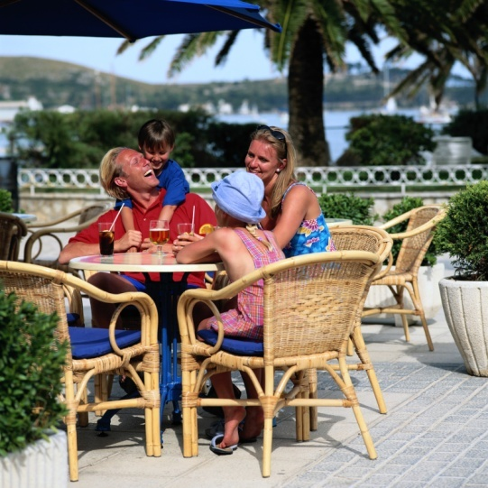
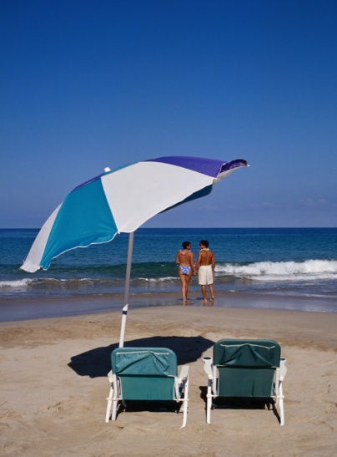
Leisure Travel Trends
In decline since Q3 ’08; expected to
stabilize in Q4 ‘09
Travel still viewed as a “right”
Shorter, closer-to-home trips
Frugality reigns - Quest for values and deals
Trading down, not out

Slide 31
Number of leisure travelers down in 2009
Percent of U.S. adults taking a leisure trip in past 12 months
Source: U.S. Travel Association and YPartnership travelhorizons™

Slide 32
Leisure travel intentions weaken
* Percent of U.S. adults intending to take leisure trip in next six months
Source: U.S. Travel Association and YPartnership travelhorizons™

Slide 33
Budget concerns remain top reason not to take leisure trips
Reasons among U.S. adults with no leisure travel intentions for next 6 months
Source: U.S. Travel Association/Ypartnership’s Travelhorizons™

Slide 34
Leisure Travel Behavior: First signs spending may strengthen
Changes in leisure travel behavior in next six months compared to same period in 2008
Source: U.S. Travel Association/YPartnership travelhorizons™

Slide 35
Leading Travel Indicator on the rise

Slide 36
Most destinations report flat or declining domestic leisure visitation in 2009
Source: U.S. Travel Association – Survey of 35 states/cities, October 2009

Slide 37
Most destinations expect some recovery in leisure visitation in 2010
Source: U.S. Travel Association – Survey of 35 states/cities, October 2009

Slide 38
Some types of attractions doing better than others
Larger attractions with bigger price tags having more difficult time than smaller attractions
Theme park attendance down in most places
Casino operators are struggling
Museums tending to do better with attendance but hurt by declining donations and public financing
Zoo attendance up across the Midwest
County fairs doing booming business

Slide 39
Projection for 2009—and Beyond
Mixed bag of results with lower-priced, closer-to-home attractions picking up attendance while more expensive attractions that are further from home hit worse.
The hope is that we bottomed out in August or September, and that the fourth quarter will show some improvement.
Aggregate Attractions Forecast
-4 to -6% in 2009

Slide 40
Projection for 2010—and Beyond
2010 & beyond will be marginally better, but real post-recession growth still likely 18-24 months away.
The best projection for aggregate attraction industry performance in 2010 is flat performance.
40

Slide 41
Ken Burns’ “The National Parks – America’s Best Idea”

Slide 42
National Parks outperforming many other attractions - at least in visitation
286.4 million visitors projected for 2009 – up 4% over 2008
But overnight stays did not increase and guests spent less
Higher personal value/lower personal cost properties
National Tourism Strategic Plan – cooperative tourism marketing
Up to $2 billion to be invested by federal government
292.8 million visitors forecasted for 2010 – up 2.2%
Source: National Park Service

Slide 43
Other nature-based tourism trends
More camping and less more expensive recreational activities
Visits to state and local parks increase in 2009 – nights up 11% through Q3 ’09
Ski visits down 5% last year with destination resorts in west hurt most – looks better for this year
Big purchase sales of boats and RVs down significantly – recovery underway
Continuing drop in youth participation
Being green can be profitable – sustainability makes business sense
Source: American Recreation Coalition, Recreation Vehicle Industry Association, International Ecotourism Society

Slide 44
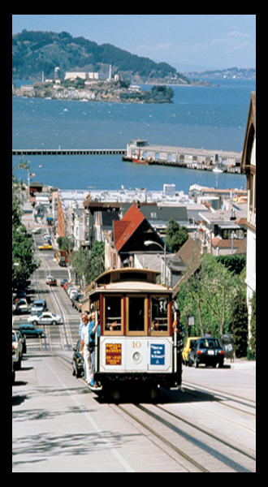
Cultural/Heritage Travelers
A Large, Affluent Market
Large: 118.3 million adults annually _{(78% of leisure travelers)}
Core Market: “Passionate” and “Well-Rounded” Segments (26%, 40 million)
Affluent: 33% report incomes <$75K
_{Spend more: $994 vs. $611}
Travel more 5.01 vs. 2.98 trips frequently: in the last year
Stay longer: Average 6 nights per trip
Notes:
A confirmation that this is A Large, Affluent Market – 78%/118.3 Million Adults Annually
HHI: 33% over $75,000
Spend More: $994 vs. $611
Travel More Frequently: 5.01` vs. 2.98 in last year
Stay Longer: Average 6 nights

Slide 45
Conclusion 6
Business travel has been under siege and….
Recovery here will be prolonged

Slide 46
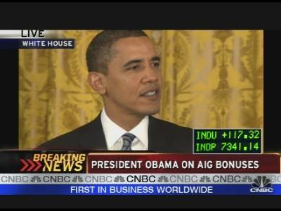
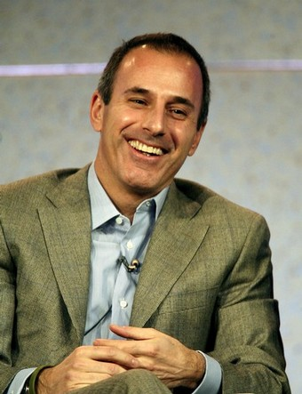
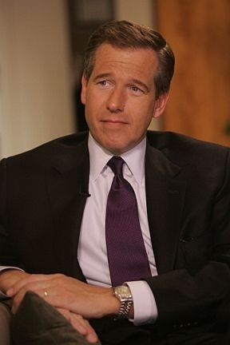
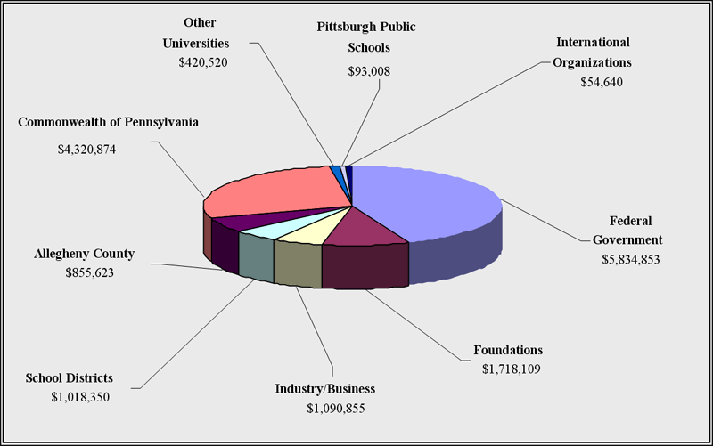
Travel: Frivolous or Necessary?
Unnecessary
Dispensable
Frivolous / Luxury
Necessary
Core Business Function
Commonplace
Notes:
Changing travel’s identity – becoming necessary rather than frivolous – will not happen overnight.
We will need a concerted, holistic and smart strategy.
That strategy begins by setting a baseline:
What do people think of travel?
Why do they think the way they do?
And, what might make them think differently of travel and the industry as a whole?
At the spring board meeting, Rich Thau, President and Founder of Presentation Testing, talked about the process we might go through to better understand how target audiences would answer these questions.
Since then, he held individual conversations with a dozen key opinion leaders and surveyed 400 more to get their views on travel and its importance relative to other industries.
The information Rich is about to present is, in some respects, disappointing. On the other hand, Rich’s data further confirms the immense opportunities available to this industry if we can harness its economic, grassroots and intrinsic powers.

Slide 47
Number of business travelers down in 2009
* Percent of U.S. adults taking a business trip in past 12 months
Source: U.S. Travel Association and YPartnership travelhorizons™

Slide 48
Business travel intentions remain weak
* Percent of U.S. business travelers’ plans in next six months
Source: U.S. Travel Association/Ypartnership’s Travelhorizons™

Slide 49
Business Travel – A Fragile Recovery
New corporate culture - Strict controls and efficiencies in corporate travel policies
Technological in-roads
Rates and fares expected to be flat or down slightly in 2010
Some expect businesses to travel more
in 2010 (NBTA) and spending to follow
A “New Normal” here too?

Slide 50
Nearly half of destinations report 2009 business visitation decline of 5% or more
Source: U.S. Travel Association – Survey of 35 states/cities, October 2009

Slide 51
And more than half expect flat to declining business travel visitation in 2010 as well
Source: U.S. Travel Association – Survey of 35 states/cities, October 2009

Slide 52
Conclusion 7 There is some light on the horizon

Slide 53
Travel Snapshot for Year End 2009
 | Leisure (Domestic) | Business (Domestic) | International
Visitors | - 2.0% | -6.2% | -8.2%
Expenditures | - 5.3% | -10.9% | - 12.9%
Silver Lining | Travelers trading down, more than trading out | Has possibly hit bottom | Surpasses record by 2013
Sources: U.S. Travel Association; Tourism Economics;
U.S. Department of Commerce-Office of Travel and Tourism Industries; TNS TravelsAmerica

Slide 54
In the End - U.S. travel industry will lose an estimated $61 billion in 2009
2008 versus 2009 Expenditures
Total Direct Travel Spending
$772.9 Billion/$712.0 Billion
Domestic Travel Spending
$662.4 Billion/$616.1 Billion
International Travel Spending in the U.S.
$110.1 Billion/$95.9 Billion
Sources: U.S. Travel Association; Tourism Economics;
U.S. Department of Commerce-Office of Travel and Tourism Industries; TNS TravelsAmerica
Notes:
But what about the other $660 billion of our industry?
That’s where the opportunity is.
To become a bigger player in domestic leisure travel, meetings and events, and transient business travel is take this organization and this industry to new heights.

Slide 55
Collapse gives way to a modest recovery
* U.S. Domestic Travel Volume yoy % change
Source: U.S. Travel Association and Tourism Economics

Slide 56
The Period of Decline
Both leisure and business travel spending had a significant decline since 2007, though the trend started to become less negative at mid-year 2009
Travel Spend Change 2007-2009 (YOY)*
May 2009
*Reflects a rolling 3 month period
Source: American Express

Slide 57
A slow international inbound travel recovery as well
* U.S. Domestic Travel Volume yoy % change
Source: U.S. Travel Association, Tourism Economics and Office of Travel and Tourism Industries

Slide 58
International Visitors to U.S. (2000-2010)
Arrivals in Millions
2000: Unmatched record year for overseas arrivals
(26.0 m)
Sources: U.S. Travel Association; Tourism Economics; U.S. Department of Commerce-Office of Travel and Tourism Industries;
Secretaria de Turismo (Mexico); Statistics Canada
Notes:
58
Visitor volume in 2007 should easily break the long-standing 2000 record of 51.2 million. As you may recall, we had forecast a record last year at this time for 2006, but were disappointed when Mexico’s final estimate came in at a lower-than-expected growth level.
Overall, international traveler growth is expected to average about 4% annually after 2007.

Slide 59
Expected “gains” in 2010: Not enough to offset 2009 declines
Domestic
Leisure
Volume
Domestic
Business
Volume
International
Visitors
Domestic
Spending
Int’l
Spending
1.9%
2.5%
(-2.0%)
(-6.2%)
2.8%
(-8.2%)
Remember: Increases coming off
a really bad 2009
4.4%
4.7%
(-12.9%)
(-7.1%)

Slide 60
The U.S. lodging industry – Better but not good
Source: Smith Travel Research

Slide 61
What to Expect in 2010 (Assuming no swine flu pandemic in U.S)
Slow improvement in the economy and the travel and tourism industry;
Often smaller losses rather than positive gains;
More reductions in air flights – return to immediate post-9/11 levels
Increases in international visitation, but return to previous levels not likely to occur until 2013;
Consumers still wary of spending money on large-ticket items;
Rising unemployment dampening ability of consumers to support economic growth
A “New Normal” in both leisure and business travel?

Slide 62
Conclusion 8
Wild cards could keep us on our toes

Slide 63
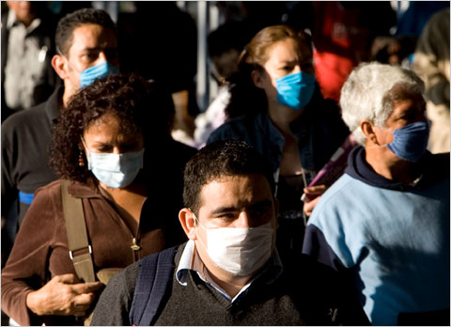
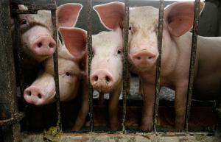
If swine flu (H1N1) becomes pandemic in U.S. – All bets are off

Slide 64
Status Overview
WHO has affirmed no travel restrictions
CDC says swine flu should not
discourage people from traveling
Travelers should heed the advice
of medical experts
Individuals should take common sense steps
to protect themselves
Swine flu, according to medical experts,
appears no more severe than seasonal flu

Slide 65
Latest News
Impact
Vaccines
Concerns
Only half of Americans say they will get vaccinated
Since no immunity, increased risk of infection
Reported increase in number of children with flu symptoms in some states
Began nationwide immunizing campaign in early October
Predatory online “pharmacies” dispensing junk medicine
Areas hit hard in spring seeing less now
Most contracting virus have only mild illness
Medical workers, children, pregnant women, adults with underlying health problems are priorities
250 million doses will be available

Slide 66
Recent U.S. Travel Activities
Engaging Government Agencies
Work alongside federal partners
CDC, HHS, DHS, Commerce, Transportation
Aligning With Global Health Officials
Toolkit of industry resources
Coordinate future industry responses
Outreach to White House
Webinars, industry events
World Health Organization
U.N. World Tourism Organization
Comprehensive Industry Communications
Notes:
While the situation seems to be under control for the moment, we will continue to remain vigilant in order to assure all messaging affecting travel is communicated responsibly and appropriately.
We recently met with the Mexican ambassador to discuss ways to cooperate with communication plans to minimize the impact on North American travel if there is an outbreak in the fall.
We are developing a comprehensive plan to ensure all of the appropriate federal agencies are including us and cooperating with us as plans are being prepared for a fall resurgence of swine flu.
We are working closely with the Administration and health organizations to ensure coordination and responsible communications about the virus and its effect.
We are also in continuous contact with the World Tourism Organization and World Health Organization to ensure we have the latest information.

Slide 67
Another, longer-term, wild card…..

Slide 68
Updates on Climate Change Legislation
In June, the House passed climate legislation including energy conservation measures and “cap and trade” to achieve reduction in greenhouse gas emissions.
Senate making slow progress moving this along because of focus on health care reform legislation. No single bill. Comprehensive climate bill from Senate unlikely this year.
U.S. Travel continues to monitor and to demonstrate efforts of travel community to be sustainable

Slide 69
Concern about global warming rising
Source: U.S. Travel Association and Ypartnership, TravelhorizonsTM

Slide 70
Impressive gains in familiarity with “Green Tourism” and “Carbon Footprint”
Familiarity with Green Tourism
Familiarity with Carbon Footprint
Source: U.S. Travel Association and YPartnership’s TravelHorizons ™

Slide 71
But purchase of carbon offsets lags
Source: U.S. Travel Association and Ypartnership’s TravelHorizons ™

Slide 72
Less than 10% will pay more for “Green” Travel but 1 in 4 “might”
78% say willing to pay less than 10% more
Source: U.S. Travel Association and Ypartnership’s TravelHorizons ™

Slide 73
We as an industry need to do a better job
Americans believe travel can have positive impact on environment, but
2/3 say there is too much “greenwashing” in travel marketing
Only 1/3 know how the industry is engaged and less believe it’s easy to learn about “green travel” programs
22% plan to travel less in future to help protect environment, and 17% feel travel is bad for the environment
While 41% feel it is their inherent right to travel, 49% believe we need more government regulation and 34% support proposed climate change legislation

Slide 74
TravelGreen.org

Slide 75
Conclusion 9
Being creative, nimble, and willing to “fail fast” required

Slide 76
Achieving Success with Online Travel Marketing in 7 Easy Steps
Keep doing search
Don’t ignore the power of branding online
Engender trust
Get social!
Engage with online video
Go mobile
Test, test, test

Slide 77
Other Marketing Recommendations
Loyalty Marketing
Integration of online and offline media
Thinking inside the box

Slide 78
Conclusion 10
You’re going to need us researchers more than ever in 2010!

Slide 79
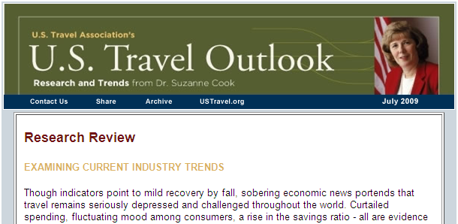
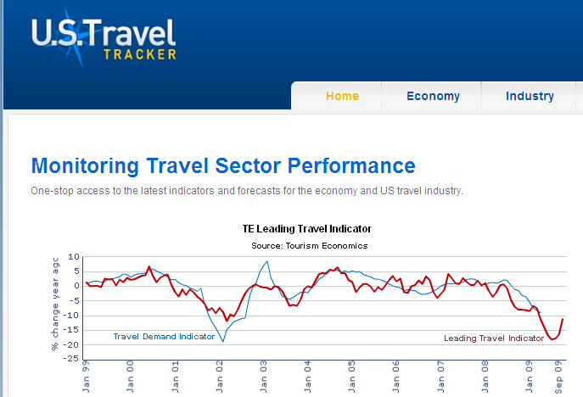
Research Resources
U.S. Travel Outlook Distributed monthly
to membership
Quarterly, future-oriented survey available through sponsorship/subscription from U.S. Travel and Ypartnership
USTravelTracker.com
Online subscription service from U.S. Travel and
Tourism Economics

Slide 80
“Risk comes from not knowing what you're doing.” --Warren Buffet

Slide 81
MOF
ESTO
www.ustravel.org
scook@ustravel.org

